Slide 1
HOUSING SALE PRICE PREDICTION
- AAYUSHA SURYAWANSHI

Slide 2
OUTLINE
01
PROJECT SUMMARY
02
TECHNOLOGY USED
03
HOW IT WORKS?
04
WHAT IT DOES?

Slide 3
ABSTRACT
• People looking to buy a new home tend to be more conservative with their budgets and market strategies.
• This application will help customers to invest in an estate without approaching an agent.
• The functioning of this project involves some good amount of dataset on which prediction can be done.
• This project aims to analyze various parameters like avg income, avg area etc. and predict the house price accordingly.
• It also decreases the risk involved in the transaction.
• For the price prediction we will be using Linear Regression.

Slide 4
AIM & IMPORTANCE
Buying or built a perfect house is a lifetime goal for every human being. However,
most of the people did wrong while purchase a property. Likewise, many Housing agents provide wrong information to their client about the price. Finally, many people end up buying worthless property with high value. Aim of this project is to predict the housing price and evaluate insights over price distribution of housing data set. By the end of this project we will be able to know the right price range distribution which depend over various factor. However, this project can help both clients and real estate agents to choose right price fluctuation.

Slide 5
OBJECTIVES
• To provide proper house price to the customers.
• To provide a better and fast way of performing operations.

Slide 6
NEED FOR PROJECT
• To provide best price to user without getting cheated.
• To provide proper house price to the customers.
• To provide a better and fast way of performing operations.
• To eliminate need of real estate agent to gain information regarding house prices.
• To enable user to search home as per the budget.

Slide 7
PROBLEM DEFINATION
To estimate the price of a property by manually calculating the affecting parameters required in estimating the rate of property
• Proper and justified prices of properties can bring in a lot of transparency and trust back to the real estate industry, which is very important for most consumers especially in India.
• Manual knowledge makes person confused since data may vary person to person.

Slide 8
DATA UNDERSTANDING & DATASET
Data understanding is an important factor in every data mining project. understand the data better can help to choose right model for the machine learning project. Understand the data can give us a clear picture about price distribution and fluctuation. Which can be helpful for the non-technical business leaders to understand the aspects of the project.
The data contains all information related to housing such as house age, population, location and the bedroom preference etc. These attributes are used to predict the price range distribution.

Slide 9
STEPS
Content Here
PREPARE AND CLEAN DATA SETS
VISUALIZATION
&
CORRELATION
TREAT OUTLIERS
DEAL WITH THE SKEWNESS
BUILD A MODEL BY USING PROPER ALGORITHM
STEP
6
STEP
5
CHECK ALL PARAMETERS LIKE ERRORS,ACCURACY,ETC.
STEP
1
STEP
2
STEP
3
STEP
4

Slide 10
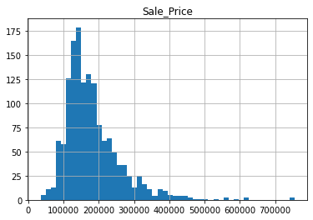
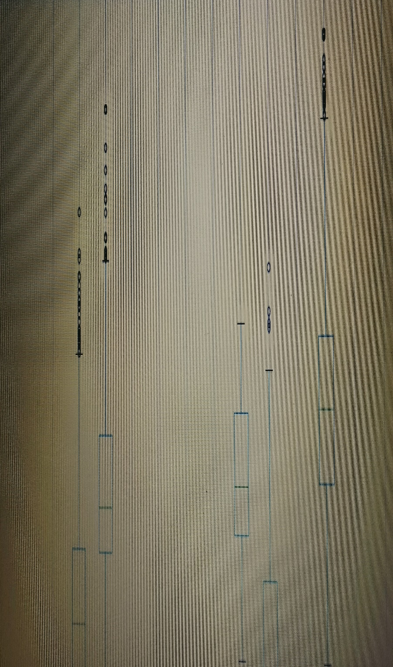
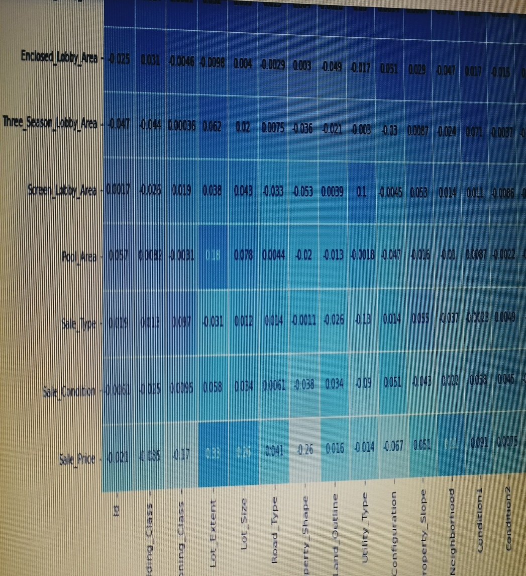
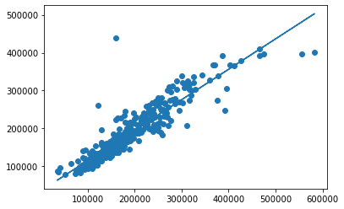
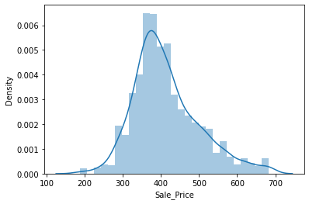
OUTLINE
GRAPHS

Slide 11
COMPARATIVE ANALYSIS
LINEAR REGRESSOR
RANDOM FOREST
RIDGE
LASSO
R Square:0.9152215
Adjusted R
Square: 0.91448301
MSE(Mean Square Error):963.6658195
MAE(Mean Absolute Error):19.48180900
R Square:0.907287
Adjusted R Square: 0.9064793
MSE(Mean Square Error):889.850809
MAE(Mean Absolute Error):19.0888928
R Square:0.983263
Adjusted R
Square: 0.9831170
MSE(Mean Square Error):874.1612229
MAE(Mean Absolute Error):19.7806988
R Square:0.9150679
Adjusted R
Square: 0.9143281
MSE(Mean Square Error):938.9490459
MAE(Mean Absolute Error):19.3583559

Slide 12
SCOPE OF PROJECT
In future we can also include, latitude, longitude and elevation of the house in the model to predict the house price with more accuracy.
Future work can also include demographics variable like income, number of children, education, age of the family group etc in the model, to explain the variability in the house pricing and to predict house pricing more effectively.

Slide 13
CONCLUSION
Thus, we studied and applied the concept of Linear Regression in real time implementation so as to ease the life of human.
• Determining the price of property without complete knowledge about the surrounding is quite riskier for both customer and the seller.
• In order to overcome this problem we have tried to develop application which determines the price of the property based on various parameters of the surrounding.
• Data provide us with the complete data about the surrounding in the form of dataset.
• Dataset helps to get the insight of the surrounding and machine learning model helps to predict the price of the property based on the training provided by the dataset.
• We successfully implemented linear regression model to predict the price of the houses.
Section Break
Insert the Subtitle of Your Presentation

Slide 14
THE END
ANY QUESTIONS?

